Slide 1

Partnership of
Connecticut Innovations Inc. (CI)
&
University of Bridgeport (UB)
Presented to
Executive Committee of the Board of Directors
April 2, 2010
Tarek M. Sobh, Ph.D., P.E.
Vice President
Graduate Studies and Research Division
Dean of the School of Engineering
E-mail: sobh@bridgeport.edu
Tel: 203.576.4116
Dr Gad J. Selig, PMP, COP
Associate Dean
Business Development and Outreach
Graduate Studies and Research Division
E-mail: gadselig@bridgeport.edu
Tel: 203.576.4870

Slide 2
Overview & Definition
“Business incubation is a business support process that accelerates the successful development of start-up and early stage companies by providing entrepreneurs with an array of targeted resources and services.”
- National Business Incubation Association (NBIA)

Slide 3
Value Proposition/Objectives
Nurture and facilitate growth of new businesses and jobs in high technology and technology ventures
Foster and stimulate economic development and job creation in Greater Bridgeport, Fairfield County and the State of Connecticut
Support and enable the growth and commercialization of UB’s applied research & Intellectual Property initiatives (e.g. U.S. Army Hybrid Projectile Design initiative – part of $2.4 million grant; NSF Smart Browsing Systems for Endoscope videos – $147,655 pending grant)
Build synergy and collaboration among industry, education and government sectors
Become self-sustaining: generate revenues through rent income, IP royalties, license fees, sponsor contributions, grants, donations, etc.
Leverage educational, faculty, student interns and facility resources for career and economic development

Slide 4
U.S. Market Dimensions – Incubators & Small Businesses
Approximately 1 million small businesses start up each year;
It is the fastest growing market segment ⁽¹⁾
High survival rates: 87% of incubator graduates still in business within 5 years ⁽²⁾
84% of graduates still in the same community as their incubators ⁽²⁾
Small businesses are responsible for 60% - 80% of net new jobs annually ⁽²⁾
Small businesses provide an essential role in economic development and sustainability ⁽²⁾
Source: (1) U.S. Department of Labor, April 2008
(2) National Business Incubator Association (NBIA), 2007

Slide 5
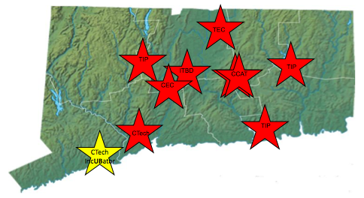
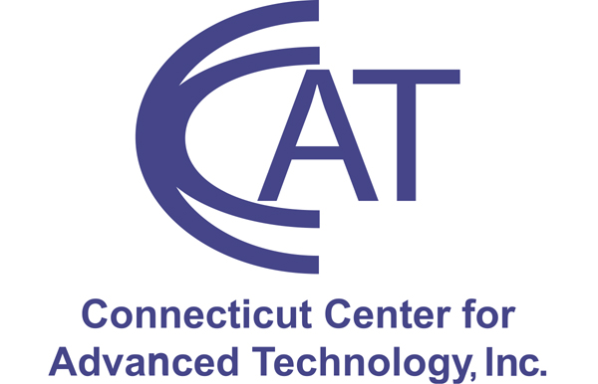







Where are Connecticut’s Incubators Located?
In Process
(only University-based incubator in Fairfield County)

Slide 6
CTech, New Haven – Connecticut Innovations
Company Data
Source: CTech

Slide 7
Target Market – CTech IncUBator @ University of Bridgeport
    Greater Bridgeport / Fairfield County / Connecticut:
      New start-ups
      Early stage companies
      Connecticut Innovations Portfolio Companies
    UB Students / Faculty:
      School of Engineering
      School of Business
      Schools of Health Sciences
      Shintaro Akatsu School of Design

Slide 8
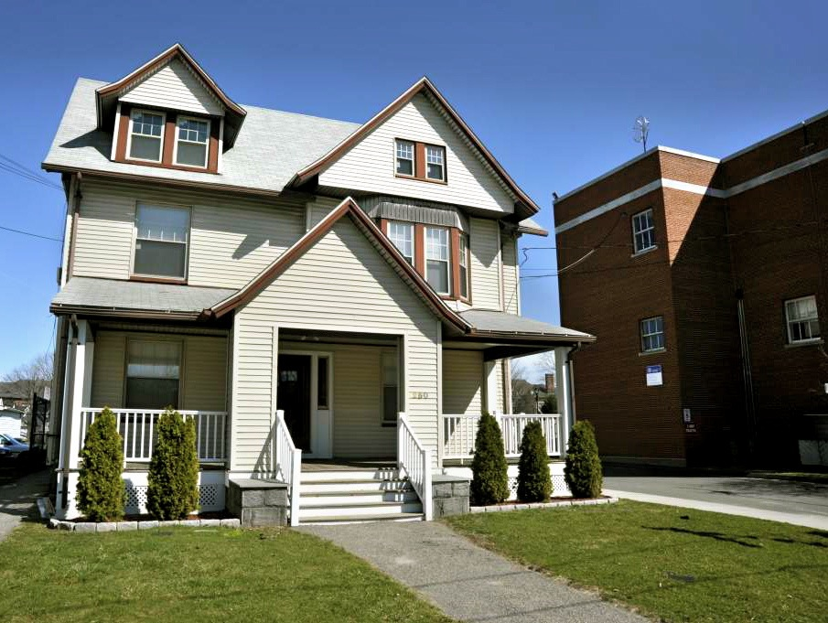
250 Myrtle Avenue, Bridgeport, CT 06604
Six offices ranging from 130 to 240 sq. ft.
Shared conference room with Monitor
Shared Kitchen
  Internet Access
  Security camera linked to UB security
  Shared Copy/Fax/Printer

Slide 9
CTech IncUBator Tenant Services & Resources:
Tenants will be candidates for CI’s Pre-Seed & Seed funding programs
Access to Library & Coffee Bar
Joint research and grant collaborations
Access to Student Interns / Employees & Faculty
Access to Gym & Pool
Access to Knights End Cafe
Pro Bono sponsorship services from professionals (e.g. Legal, Tax, Technology, Engineering, Finance, Venture Capital, Marketing, IP, etc.)
Monthly “Entrepreneurial Brown Bag” Lunch Seminars & Workshops (Conducted by SCORE, UB Faculty & External Subject Matter Experts) in the IncUBator’s conference room or the Library’s Discovery Pavilion
Access to SCORE Counselors
Access to public & private grant funding (with UB) & external sponsorship funding (e.g. UI)
UB and/or CI to provide financial and/or in-kind resources to assist non – UB tenants to commercialize their products/IP for a fair ROI
Access to Labs (Future)

Slide 10
Operating Principles
Non-profit
Board of Advisors
Pro Bono sponsorship by professional service firms
Become self – sustaining
Reinvest in upgrading facilities (Offices, Labs (future), etc.)
Pursue collaborative grants, funding opportunities, IP licenses/royalties, etc.
Help to commercialize UB developed IP and tenant developed IP (when using UB resources – faculty, labs, etc.)

Slide 11
Potential Pro Bono Sponsorship Firms
List by Professional Services
Law:
Pullman & Comley LLC
Cohen and Wolf, P.C.
Others
IP:
Monahan & Costello, LLC. – IP/Tech Transfer
Accounting/Tax:
BlumShapiro
Dworken Hillman, LaMorte and Sterczala, P.C.
Friedberg, Smith & Co., P.C.
Others
Investment Bankers:
Carter Morse & Mathias
Others
Marketing/PR:
Creative Partners – PR
Other
Specializations to be added:
Engineering/Technology
Product Development/Commercialization
Angel Investors/Venture Capitalists
Others

Slide 12
Implementation Milestones
Milestone | Target
CI / UB Agreement Signed | March 4, 2010 - Completed
Prepare Building & Ready for Occupancy | June 15, 2010
Prepare Documents, Forms, Policies & Procedures | June, 2010
Marketing, Communications & Promotion | June – September, 2010
Form Advisory Council | June, 2010
Sign up Pro-Bono & Other Sponsors | May – August & On Going
Grand Opening | September 22, 2010

Slide 13
Questions ?

Slide 14
Thank You !
Dr. Tarek M. Sobh
Dr. Gad J. Selig

